Slide 1


Designing and Simulation of an Energy Control
Algorithm for Photovoltaic Based Active Generator using State Flow Analysis
Faculty Of Engineering
University Of Ruhuna
SANJEEWANI T.G.P RU/E/2011/158
WIJERATHNA W.M.S.M.M RU/E/2011/184
DHARMASENA G.T.S RU/E/2011/190

Slide 2
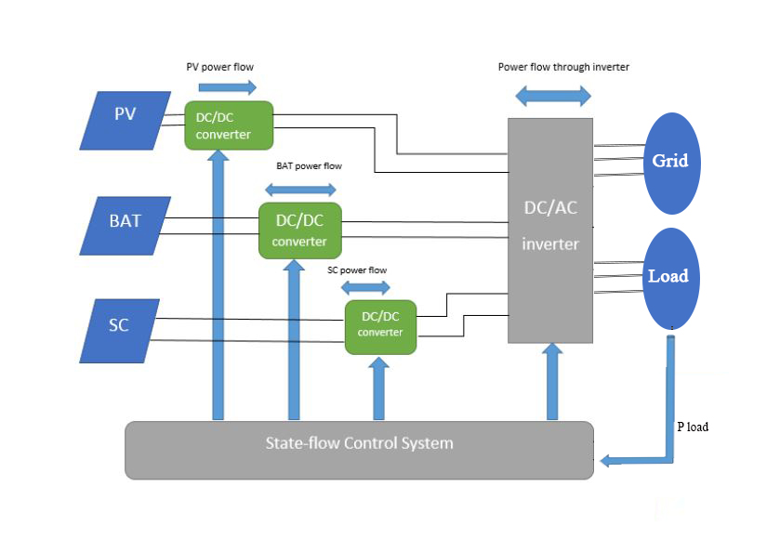
Introduction
Active Generator Concept

Slide 3

Problem Statement
Stochastic nature of PV systems
Continuously varying weather conditions
Wastage of excessive PV power produced during sunny days
Inability to supply the required power in cloudy days
Requirement of a local energy storage to store energy for long time and short time

Slide 4

Proposed Solution
Define three working modes.
Mode 1 - Normal
Battery and SC power lie between maximum and minimum capacities of battery and SC respectively. Required power is more or less than the PV produced power.
Mode 2-Constraint
SC and battery are fully charged. Required power is lower than the PV produced power.

Slide 5
Proposed Solution cont.
Mode 3-Unconnected
The capacity of the battery and the SC lie below their minimum capacity limitation. Required power is higher than the PV produced power.
Normal – Supply power to load
Constraint – Supply power to both load and grid
Unconnected – Supply power to load from grid.

Slide 6
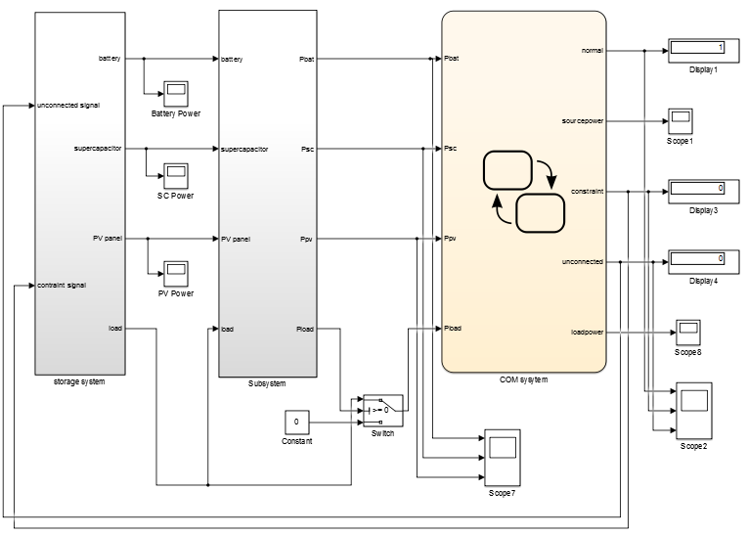
Overall System

Slide 7
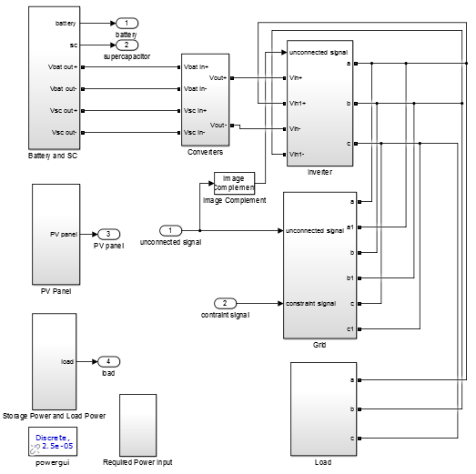
Storage System

Slide 8
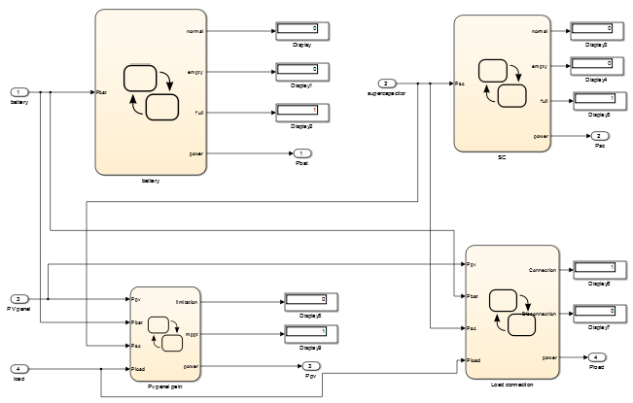
State-Flow Control Arrangement for Power Source

Slide 9
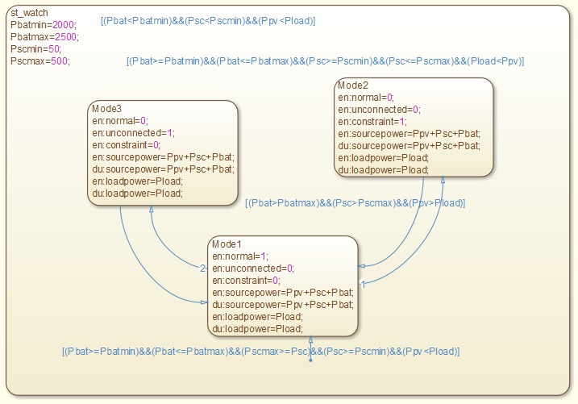
Algorithm of the Model

Slide 10
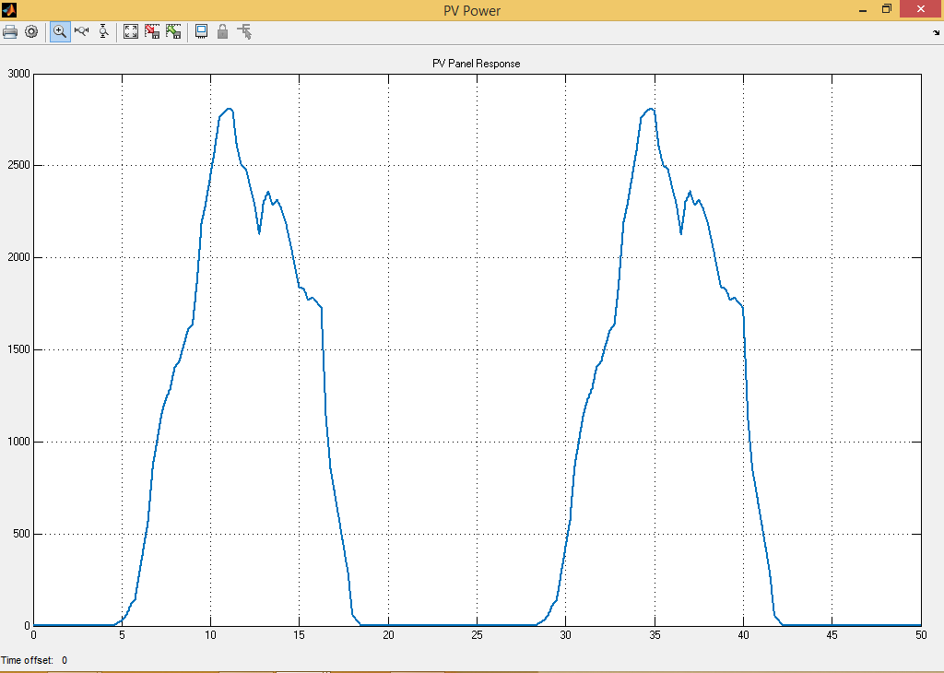
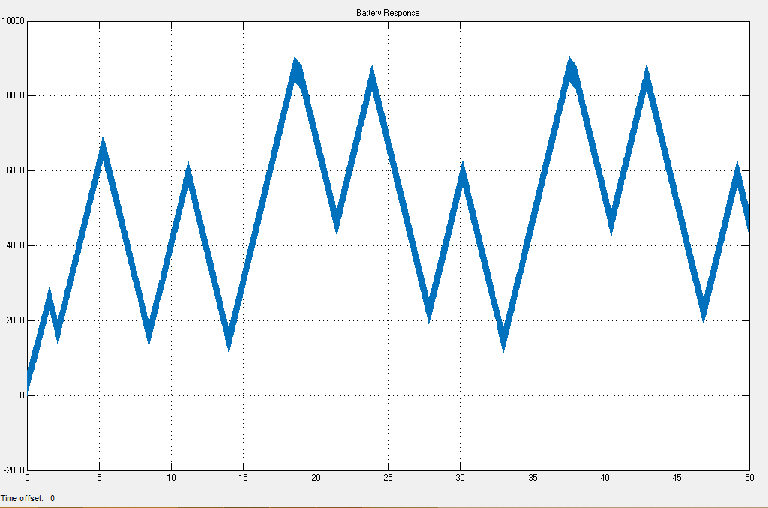
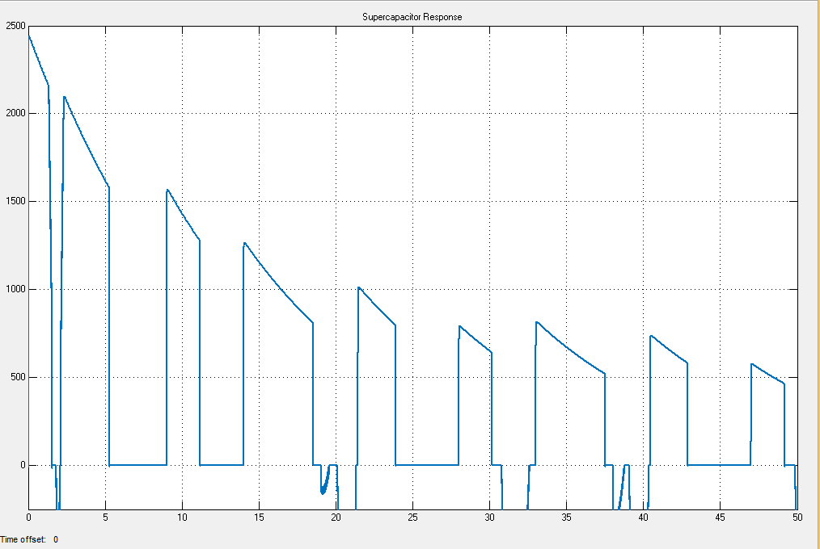
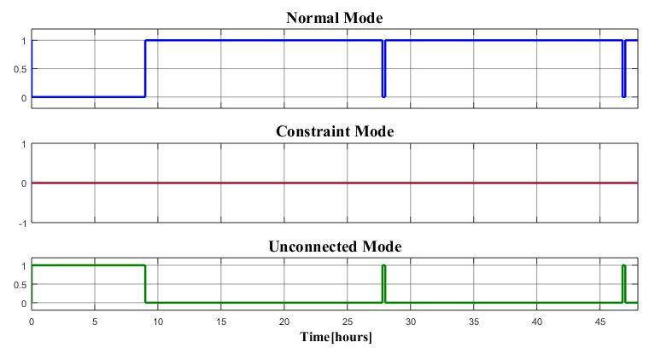
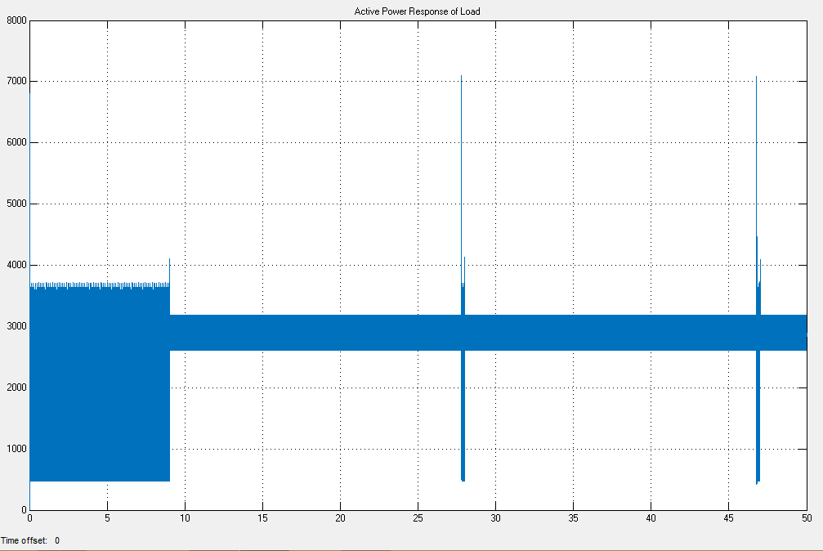
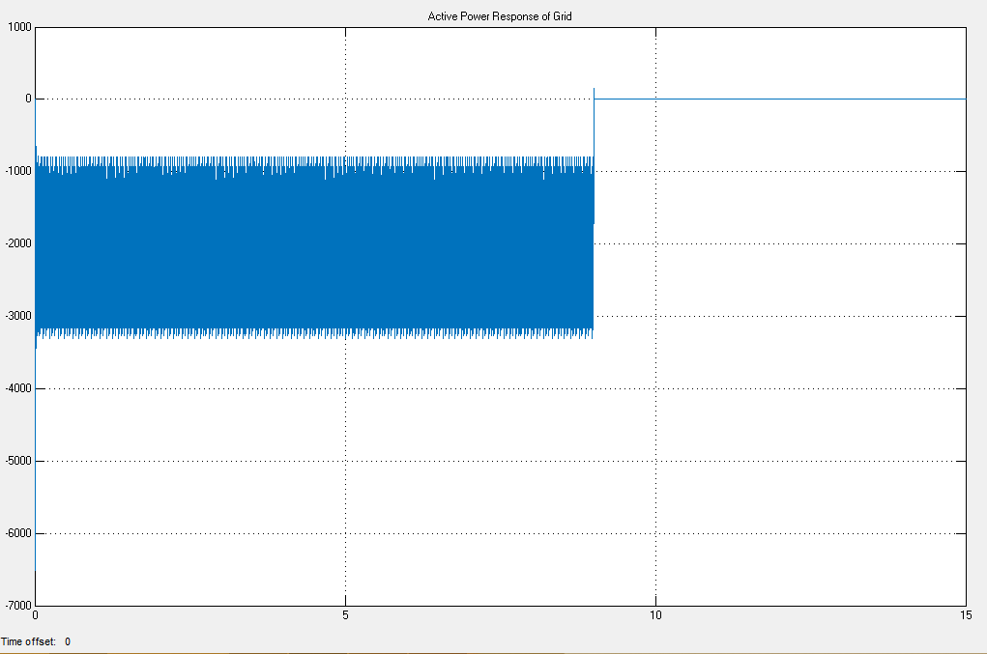
Results
PV produced Power
Battery Power Response
SC Power Response
Load Power Response
Grid Power Response
Working Modes of
the System

Slide 11
Thank You..!

Slide 12
Supplementary Slides

Slide 13
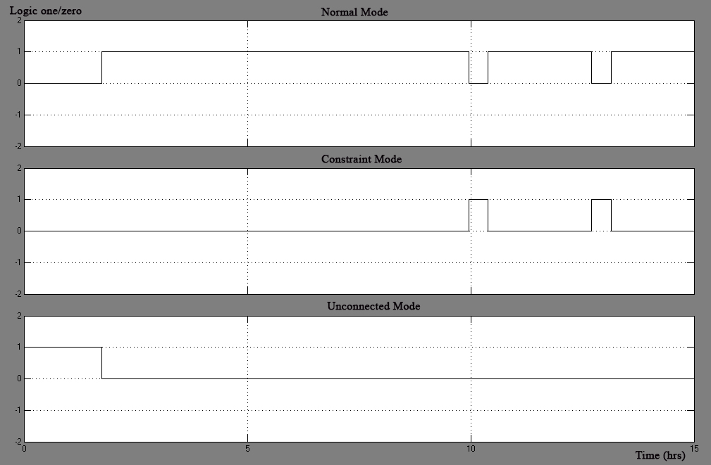
System working under Three Modes

Slide 14
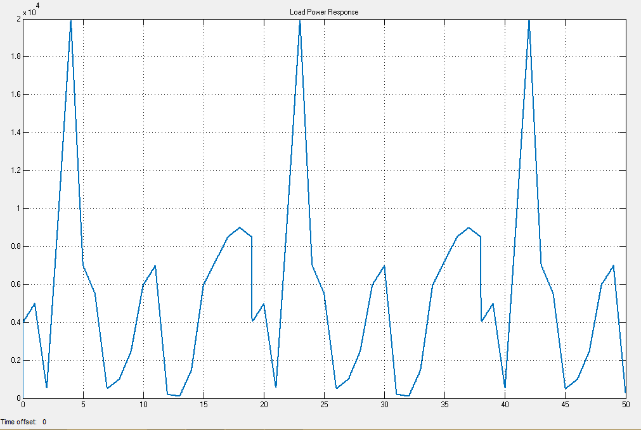
Required Load Power

Slide 15
Monthly GTI from Kristiansand in Year 2012
Month | Monthly Mean GTI (W/m²)
January | 11.75
February | 10.50
March | 150.6
April | 161.74
May | 310.88
June | 187.16
July | 185.31
August | 171.69
September | 213.07
October | 99.28
November | 22.03
December | 7.69

Slide 16
GTI Data on 31st May 2012
Time | GTI(w/m²)
10:56:00 AM | 970
11:11:00 AM | 977
11:26:00 AM | 974
11:41:00 AM | 903
11:56:00 AM | 869
12:11:00 PM | 863
12:26:00 PM | 827
12:41:00 PM | 794
12:56:00 PM | 739
1:11:00 PM | 801
1:26:00 PM | 821
1:41:00 PM | 794
1:56:00 PM | 805
2:11:00 PM | 786
2:26:00 PM | 761
2:41:00 PM | 722
2:56:00 PM | 680
3:11:00 PM | 638

Slide 17
Technical Data of Solar BP 3160N Module
Electrical data | Parameters
Nominal output Pmpp | 160 [W]
Max. Voltage system | 1000 [V]
Nominal Voltage Umpp | 35.1 [V]
Nominal current Impp | 4.55 [A]
Open circuit voltage Uoc | 44.2 [V]
Short circuit current Isc | 4.8 [A]
Module conversion efficiency | 12.7 [%]

Slide 18
Parameters of Lead-Acid Battery
Parameters | Data
Nominal Voltage | 144V
Rated Capacity | 69.4Ah
Initial State Of Charge | 100%
Fully Charged Voltage | 156.8V
Nominal Discharge Current | 13.9V
Internal Resistance | 0.02Ohms
Capacity(Ah)@Nominal Voltage | 21.53Ah
Exponential zone[Voltage, Capacity] | [146.6V 0.2Ah]

Slide 19
SC Specifications
Parameters | Data
Rated capacitance | 198F
Equivalent DC series resistance | 2.1x10⁻³ Ohms
Rated voltage | 150V
Surge voltage | 155V
Number of series capacitors | 2
Number of parallel capacitors | 4
Initial voltage | 16V
Leakage current | 5x10-2A
Operating temperature(Celsius) | 15

Slide 20

Battery Model
Discharge voltage model (i* > 0)
Edischarge=𝑓1(𝑖𝑡,𝑖∗,𝐸𝑥𝑝)=𝐸𝑜−𝐾∗( )∗𝑖∗−𝐾∗( )∗𝑖𝑡+
Charge voltage Model (i* < 0)
Echarge=𝑓2(𝑖𝑡,𝑖∗,Exp)=Eo−K∗ ∗i−K∗ +𝐿𝑎𝑝𝑙𝑎𝑐𝑒⁻¹∗( * 1/s)
where,
E_{Batt} : Nonlinear voltage (V)
E0 : Constant voltage (V)
Exp_{(s)} : Exponential zone dynamics (V)
Sel_{(s)} : Represents the battery mode. Sel_{(s)} = 0 during battery discharge, Sel_{(s)} = 1 during battery charging.
K : Polarization constant
i* : Low frequency current dynamics (A)
I : Battery current (A)
It : Extracted capacity (Ah)
Q : Maximum battery capacity (Ah)

Slide 21
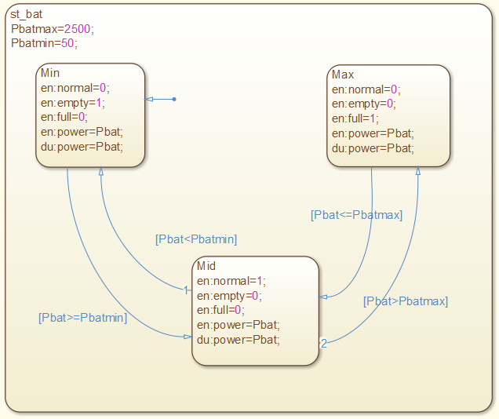
Battery Model in State-Flow

Slide 22
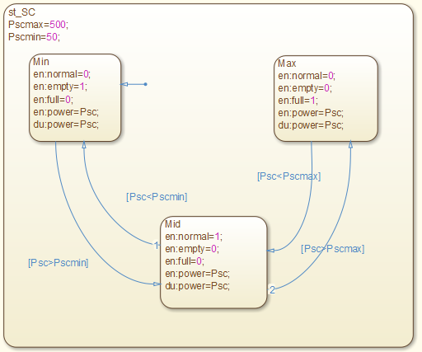
SC Model in State-Flow

Slide 23
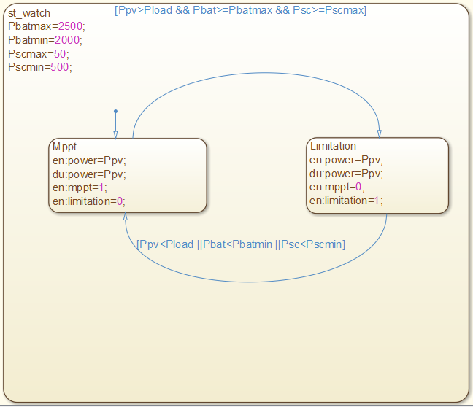
PV Panel Model in State-Flow

Slide 24
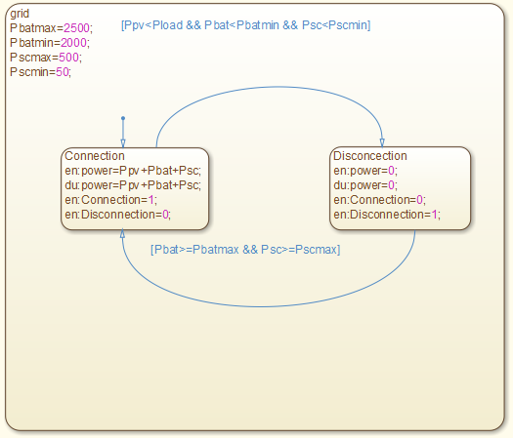
Load Model in State-Flow

